Slide 1
Commercial Air Passenger Safety
Andrea Fox
DSC640-T301 Data Presentation & Visualization
January 24, 2021

Slide 2
Agenda
Talk through fatal accidents
Look at airline incidents
Departure's data
Net profit
Summary

Slide 3

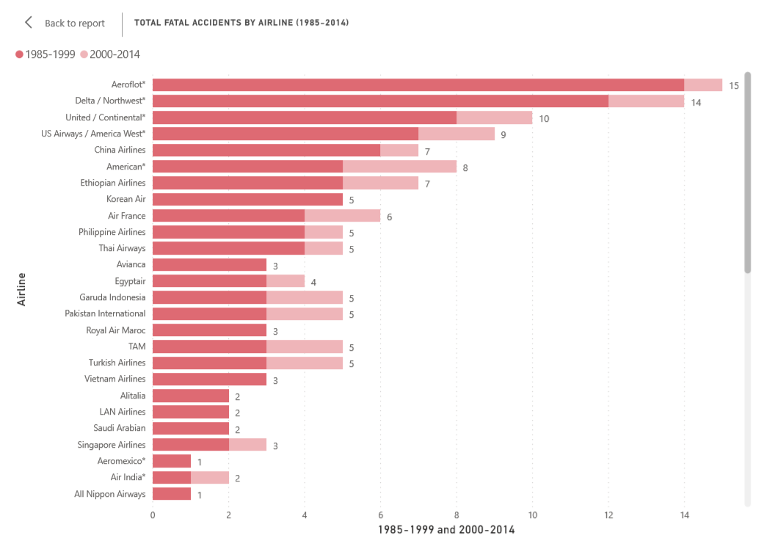
Fatal Accidents 1985-2014
Looking at total fatalities that are only related to plane accidents
Average fatal accidents from 1985-1999 = 2.18
Average fatal accidents from 2000-2014 = 0.66
1.52 difference in averages
Trending in the right direction
Notes:
Drawing attention to the fatal accidents that happened from 1985-1999 shows that most of these accidents happened earlier in the industry and that now they happen much less frequently. Some potential spikes in 2000-2014 can include 9/11 when planes were hijacked and used as a weapon. Malaysian airlines have had a few recent spikes due to one crashing in Ukraine and the other aircraft gone missing. These are specific examples of an unfortunate accident, but are mostly outlying events.

Slide 4
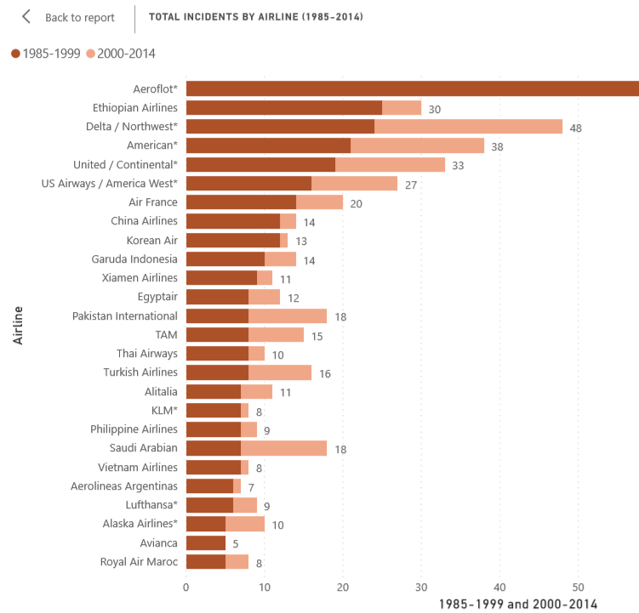
Total Incidents 1985-2014
Looking at total incidents which are defined as something that happens to aircraft with no fatalities involved.
Average incidents from 1985-1999 = 7.18
Average incidents from 2000-2014 = 4.13
3.05 difference in averages
Trending in the right direction
Notes:
Incidents happen at a more frequent number, than fatal accidents. Incidents include anything that may malfunction or break down on the aircraft, but do not cause harm to human life. It is important to note that the number of incidents were much higher in the earlier years of air travel, and have since trended downward in more recent years.

Slide 5
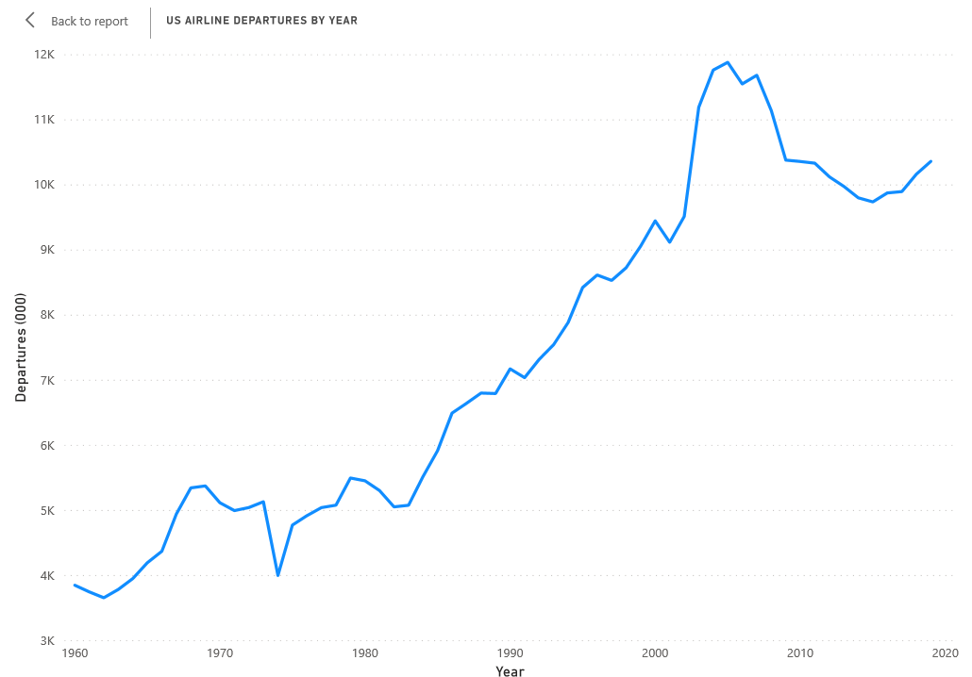
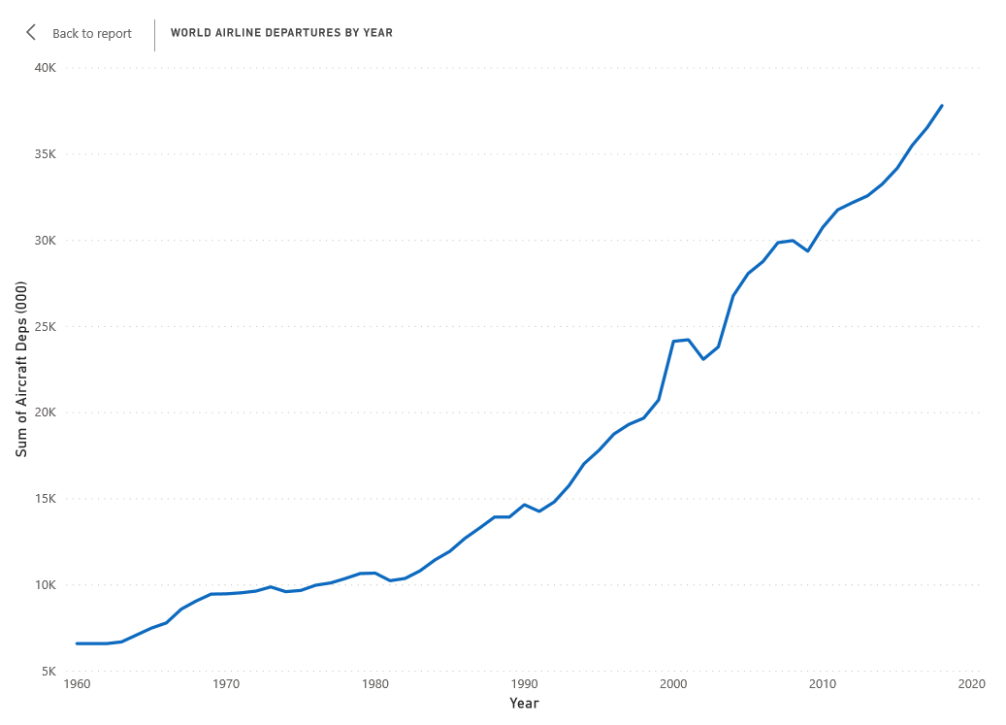
Departures
US Airline Departures
World Airline Departures

Slide 6
Departures Explained
Both US and World airlines have seen an upward trend in usage across the years
US had slight dip around 2008 due to financial recession
Customers are still using airlines for travel regardless of media misinformation
Notes:
Regardless of the media information, air travel has increased over the years. This easily shows that our customers are not being swayed by the media interpretation of being more dangerous.

Slide 7
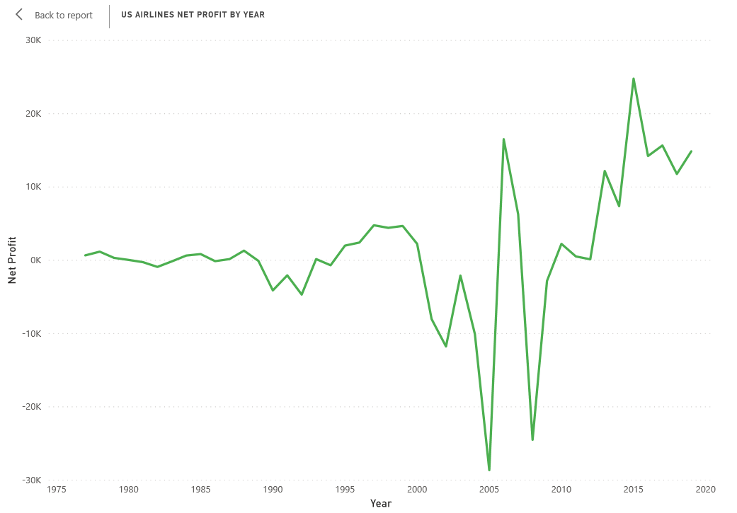
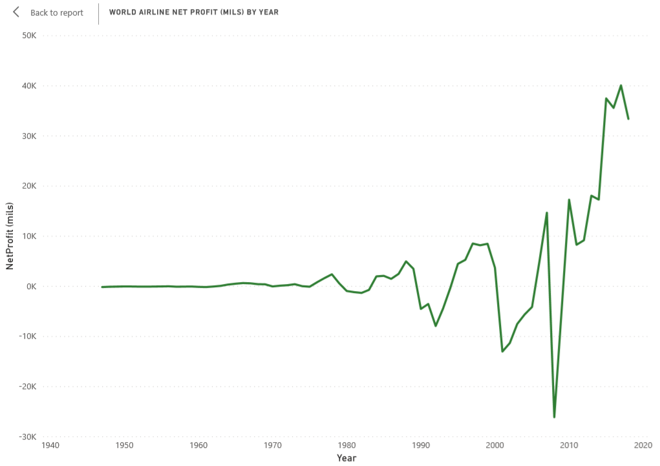
Net profit
US Airlines Net Profit
World Airlines Net Profit

Slide 8
Net Profit Explained
Net Profit has had a rocky trend, but is currently on the upward
Important to note that with Covid-19 air travel was restricted, which led to the start of downward trend in late 2019
Notable down trends happened in 2001 caused by 9/11 attacks on the United States. Also 2008, had financial recession

Slide 9
Summary
All important airline metrics are trending up
Number of fatal accidents and incidents are trending down
Airline stocks have stayed relatively consistent until pandemic started in late 2019/early 2020
Notes:
Stock market information https://www.marketwatch.com/investing/index/djusar/download-data?startDate=1/1/2000&endDate=01/22/2021&countryCode=xx

